Slide 1
TimesheetX Student Budget Manager
The College of New Jersey

Slide 2
Introduction
Provides supervisors with immediate and valuable student budget information.
Easily accessible to TimesheetX supervisors through TimesheetX pages.
Supervisors will be able to view current and projected budget information.
Can view specific employees, hire and timesheet details.

Slide 3
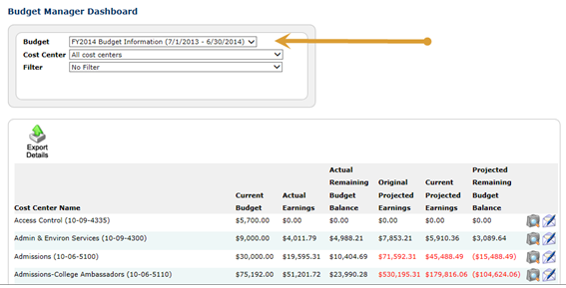
Getting Started
Click the Budget Dashboard link on the left navigation bar.
Select the budget period you want to view

Slide 4
The Budget Dashboard feature can provide the following information as long as the user has been granted access for that specific Cost Center.
Current Budget – The current allocated budget for the specified Cost Center.
Actual Earnings – Actual earnings are calculated from finalized timesheet within the current budget period.
Actual Remaining Budget Balance – The Actual Remaining Budget Balance is calculated by subtracting Actual Earnings from Current Budget Amount.
Original Projected Earnings – The Original Projected Earnings calculates the sum of all potential earnings (hourly rate times standard hours per week times number of weeks worked in job assignment) for all hires in all jobs, within the current budget period, for the Cost Center.
Current Projected Earnings – The Current Projected Earnings is calculated by adding the maximum potential earnings from timesheets within the current budget period, and not yet finalized, to the amount already finalized/paid. Timesheets that have been dismissed are not included in this calculation.
Projected Remaining Budget Balance – The Projected Remaining Budget Balance is calculated by subtracting Current Projected Earnings from Current Budget Amount.

Slide 5
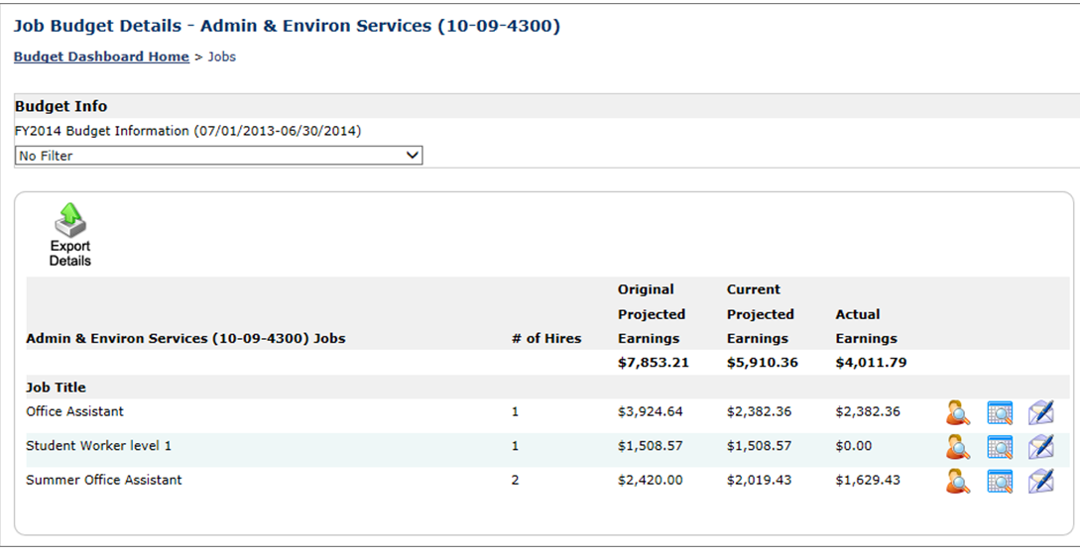
To view jobs and specific earnings associated with your department, click the View Jobs icon to the right of your department.

Slide 6
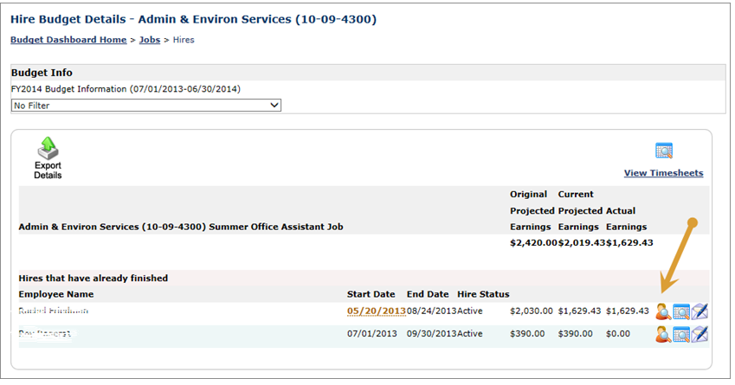
To view hire details and see specific student employees and their associated earnings, click the View Hires icon to the right of the hire you want to view.

Slide 7
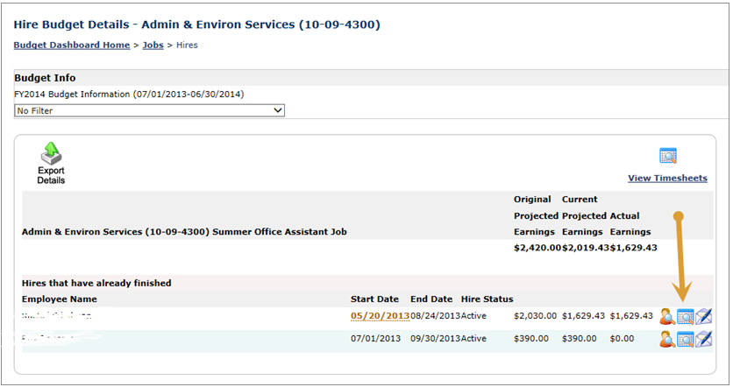
Supervisors may also view timesheets for a specific student employee. Click the View Timesheets icon to the right of the specific employee you wish to view.

Slide 8
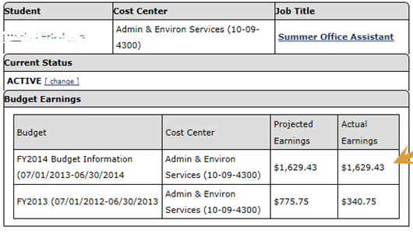
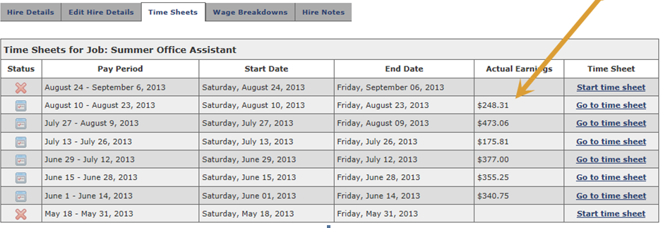

Slide 9
Important Reminders
Accurate projected earnings and projected remaining budget balances in Student Budget Manager will be affected by several key components controlled by the supervisor.
Number of Hours worked per week should be reported accurately for each student employee when the job is posted by the supervisor. Over or underestimating the hours worked per week will affect the projected earnings calculation.
Dismissing timesheets has an immediate effect on the projected earnings calculation and remaining budget balance.
Terminating student employees that end their employment prior to their original job end date will also affect budget balances. If a student employee terminates their employment prior to their original job end date, the Career Center should be notified immediately so that appropriate action can be taken in JobX.

